Slide 1

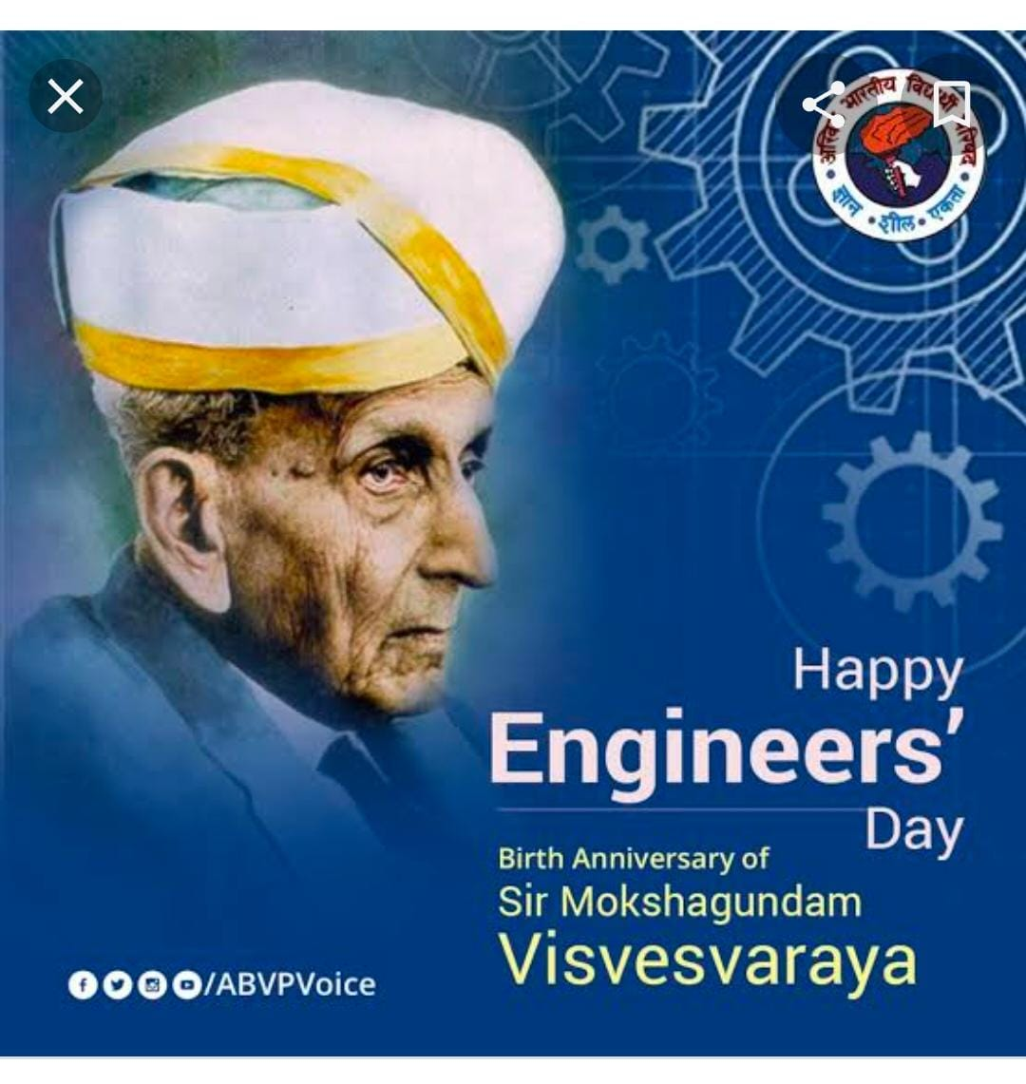
Gandhi Institute of Science And Technology KHOLIGUDA RAYAGADA ODISHA
HAPPY ENGINEER’S DAY
SUBMITTED BY,
K.AAKSSHAY KUMANDAN(B.TEC) CSE BRANCH ,REGDNO -1901317069

Slide 2
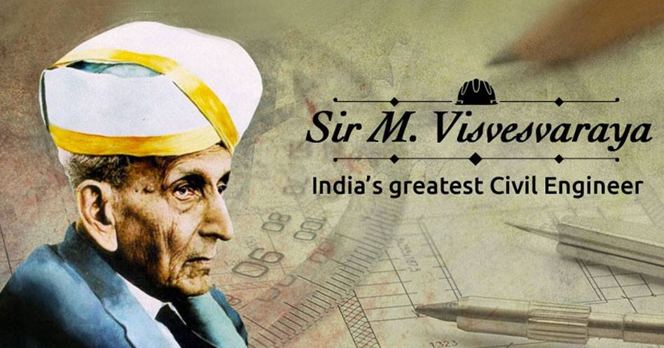
The 1st Engineer Of India
MOKSHAGUNDAM VISVESVARYA was the first engineer of India. His birthday September 15th is celebrated as Engineer’s Day in India every year.
. He got the Bharat Ratna awarded and he set up Schools and Engineering Institutions.
. Inverted blocks for irrigation and built Krishna Sagar Reservoir in Karnataka .

Slide 3

What is Modern Technology
Modern technology simplifies life in so many ways and everyone defines technology in their own way. To some people ,it means complicated electronic devices .To others ,it means the source of the radical changes that are happening in all phases of life.
Technology significantly affect humans as well as animals ability to control & adapt to their natural environments.
Technology is the making modification ,usage ,&knowledge of tools ,machine, techniques ,crafts ,system & methods of organization in order to solve a problem achieve a goal handle a applied input/output relation or perform a specific function .
Notes:
Modern technology simplifies life in so many ways and everyone defines technology in their own way. To some people, it means complicated electronic devices. To others, it means the source of the radical changes that are happening in all phases of life

Slide 4
USAGE MODERN TECHNOLOGY
Technology can be viewed as an activity that forms or changes cultures . Additionally ,technology is the application of math ,science and the arts for the benefit of life as it known.
The rise of communication technology , which has lessened barriers to human interaction and as a result has helped spawn new subcultures, the rise of cyber culture has its basic development of the internet and the computer .
Not all technology enhances culture in a creative way technology can also help facilitate political oppression and war tools like guns.
As a cultural activity ,technology predates both science and engineering each of which formalize some aspects of technological endeavor.

Slide 5


Slide 6
Advantages of modern Technology
Easier, faster and more effective communication.
Better, more efficient manufacturing techniques.
Less wastage.
More efficient stock management and ordering systems.
The ability to develop new, innovative approaches.
More effective marketing and promotion
New sales avenues.

Slide 7
Dis –Advantages of Modern Technology
Increased dependency on technology.
Often large costs involved with using the latest technology (especially for small business).
Increased risk of job cuts.
Closure of high street store in favour of online business.
Security risk in relation to data and fraud
Required regular updates
Can go down or faults ,which can stop all business operation instantly.

Slide 8
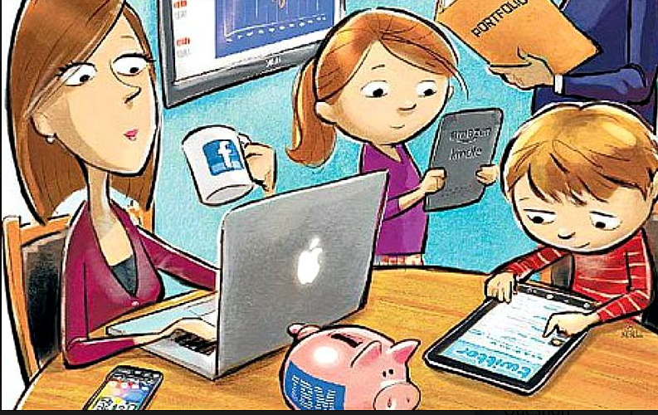
How does the affect the technology Society
Society is the environment and the people around you where you live .Technology is the good high tech that we use.
People are not getting fresh air they need because they are either phones or computer.
Too much technology is good,but it I some is bad.
The way of being a benefit technology is you can chat with friends and family members .
Technology include maps, playlist etc .

Slide 9

What is the key role Human Life in modern Technology
Humans and their characteristics play a key role in the technological area in the trade of IT products and solutions.
Technological progress creates a new environment ,where human qualities are becoming more and more important ,and it is crucial to find a balance for this situation.
Total dependency on technology in our day to day life .

Slide 10


